Slide 1
How to use Github like Silicon Valley Developers
By Altotech

Slide 2
What is Git?
Who should use Git?
Keeps track of changes
especially text changes
version1, version2, version3
Version control system (VCS)
Source code management (SCM)
Anyone wanting to track edits
Review a history log of changes made
View differences between versions
Retrieve old versions
Anyone needing to share changes with collaborators

Slide 3
Try Github!

Slide 4
Installing Git
Download
http://git-scm.com/download
Install

Slide 5
Initialize repository
Open Terminal
Go inside the root project folder
Type git init

Slide 6
Commit
Make changes
- new file, edit file
Add the changes
Type git add . (for all changed file)
git add <filename> (for any file)
Commit changes to the repository with a message
Type git commit -m “any descriptive message”

Slide 7
Git concepts and architecture

Slide 8
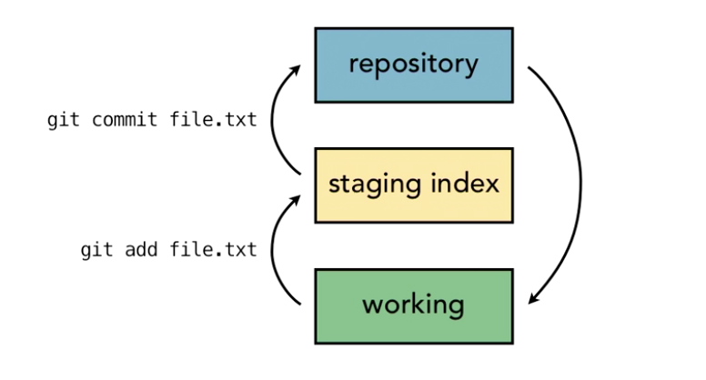
Three-trees architecture

Slide 9
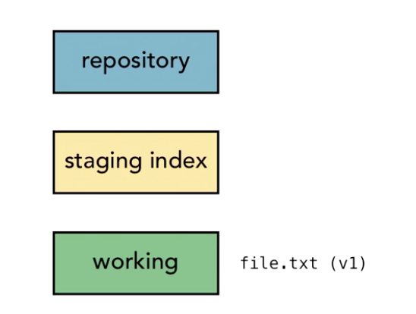
Git workflow
A

Slide 10

Git workflow
A

Slide 11

Git workflow
A

Slide 12

Git workflow
A
B

Slide 13
Git workflow
A
B

Slide 14
Git workflow
A
B

Slide 15
Hash values
Git generates a checksum for each change set
- checksum algorithms convert data into a simple number
- same data always equals same checksum
Data integrity is fundamental
- changing data would change checksum
Git uses SHA-1 hash algorithm to create checksums
- 40-character hexadecimal string (0-9, a-f)
A
B

Slide 16
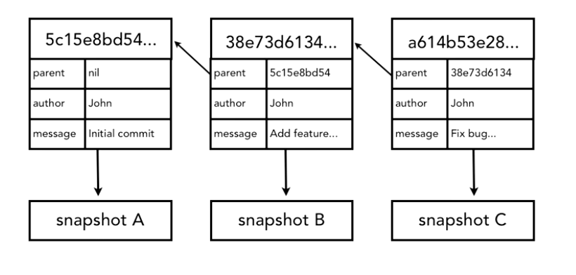
Referring to commits
A

Slide 17
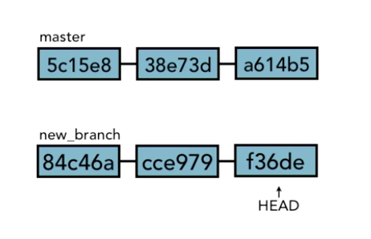
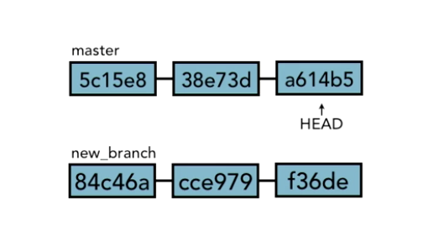
HEAD pointer
Pointer to “tip” of current branch in repository
Last state of repository, what was last checked out
Points to parent of next commit
- where writing commits takes place

Slide 18
Remotes
Merging branches
Branching
Commit tree
Making changes
Undo changes
Ignoring changes
Stashing changes

Slide 19
Undoing changes
git checkout -- <filename> (for undoing any file)
git reset HEAD <filename> (for unstaginging any file)

Slide 20
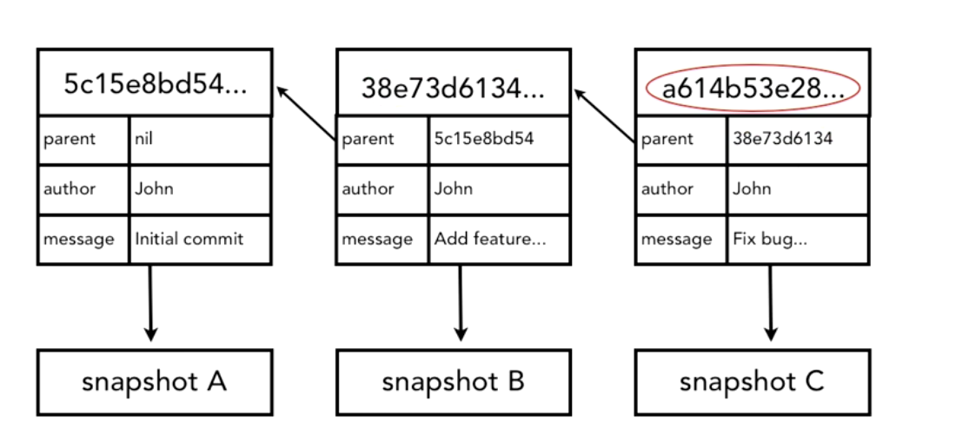
Amending commits
Retrieving old versions
git commit --amend -m “Message”
git checkout <SHA> -- <filename>

Slide 21
Undoing commits
git reset --hard <SHA>
--soft : does not change staging index or working directory
--mixed(default) : changes staging index to match repository and does not change working directory
--hard : changes staging index and working directory to match repository

Slide 22
Ignoring files
project/.gitignore
*.php, !index.php

Slide 23
Navigating the commits tree
Parent commit
  HEAD^, acf57504^, master^
  HEAD~1, HEAD~
Grandparent commit
  HEAD^^, acf57504^^, master^^
  HEAD~2
git ls-tree HEAD git ls-tree master^

Slide 24
The commit log
git log
git log --oneline
git log --since=“2012-06-25”
git log --until=“3 days ago”
git log --since=“2 weeks” --until=3.days
git log --author=”John”
git log -p

Slide 25
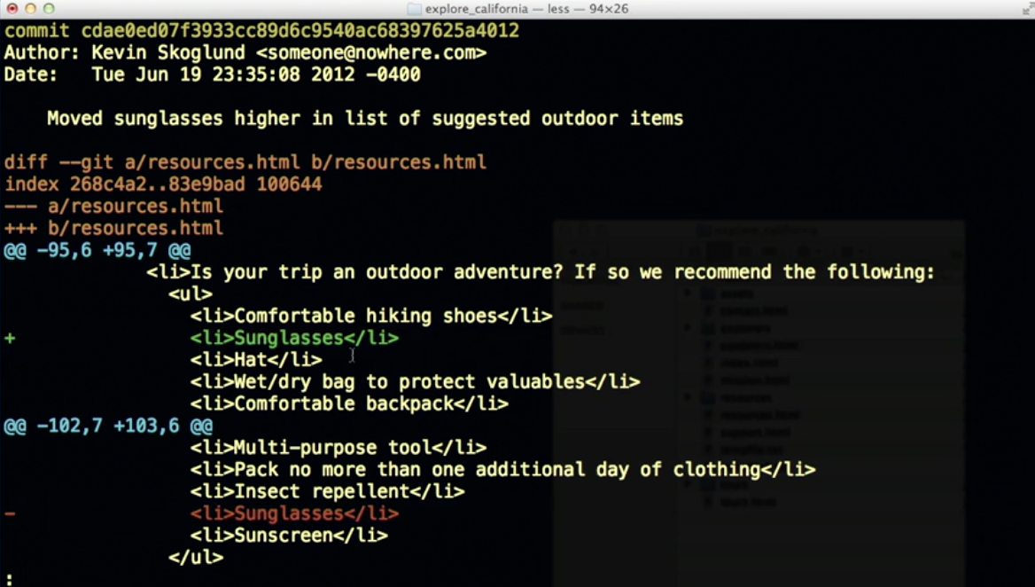
Viewing commits
git show <SHA>

Slide 26
Remotes
Merging branches
Branching
Commit tree
Making changes
Undo changes
Ignoring changes
Stashing changes

Slide 27
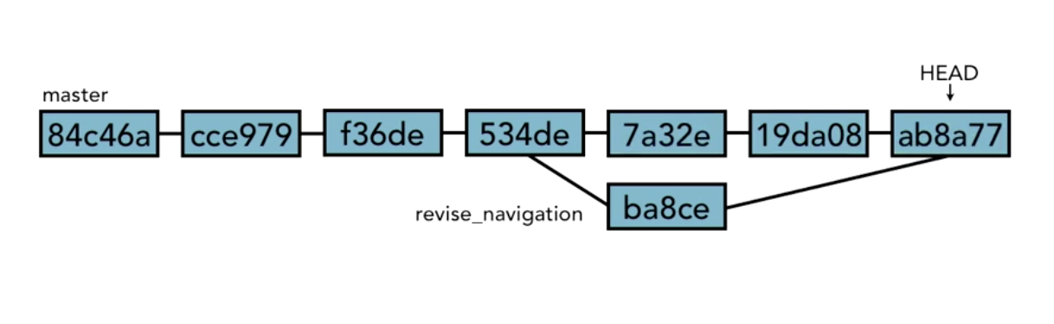
Branching
git branch (show all branches)
git branch <a new branch name> (create a new branch)
git checkout <branch name> (switch branch)
git checkout -b <a new branch name> (create and switch branch)

Slide 28
Branching
git diff <branch name> <branch name> (show differences between
2 branches)
git branch -m <branch name> <new branch name> (rename)
git branch -d <branch name> (delete branch)

Slide 29
Merging branches
git merge <branch name> (merge a branch into HEAD branch)

Slide 30
Merging branches
git merge <branch name> (merge a branch into HEAD branch)

Slide 31
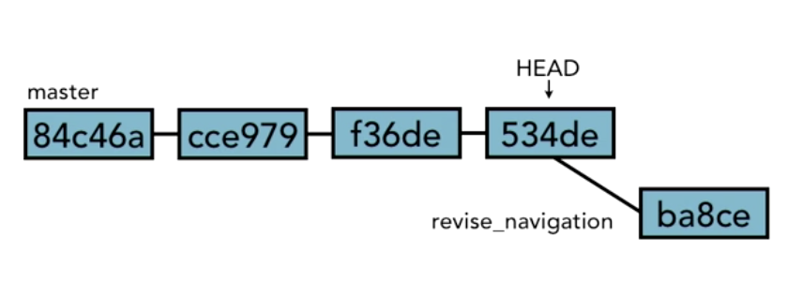
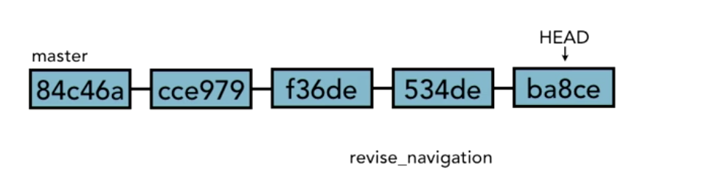
Using fast-forward merge vs. true merge
git merge --ff-only <branch name> git merge --no-ff <branch name>
fast-forward merge
true merge

Slide 32
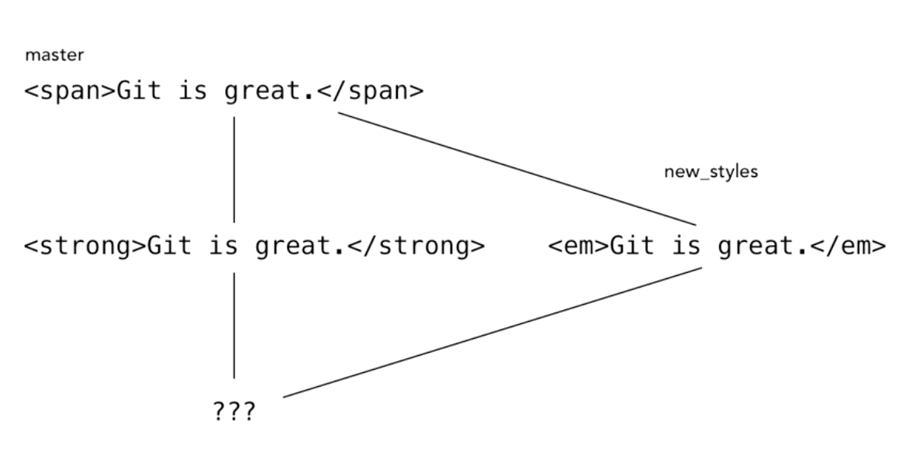
Merge conflicts

Slide 33
Resolving merge conflicts
Abort merge
  git merge --abort
Resolve the conflicts manually
  git merge <filename>
  Choose a needed version in the file
Use a merge tool
  git mergetool --tool= <toolname>

Slide 34
Stashing changes
Saving changes
git stash
git stash save ‘name’

Slide 35
Stashing changes
View stash list
git stash list
git stash show title’

Slide 36
Stashing changes
Retrieving stash
git stash pop
git stash apply

Slide 37
Stashing changes
Deleting stash
git stash drop ‘name’
git stash clear

Slide 38
Remotes
Merging branches
Branching
Commit tree
Making changes
Undo changes
Ignoring changes
Stashing changes

Slide 39
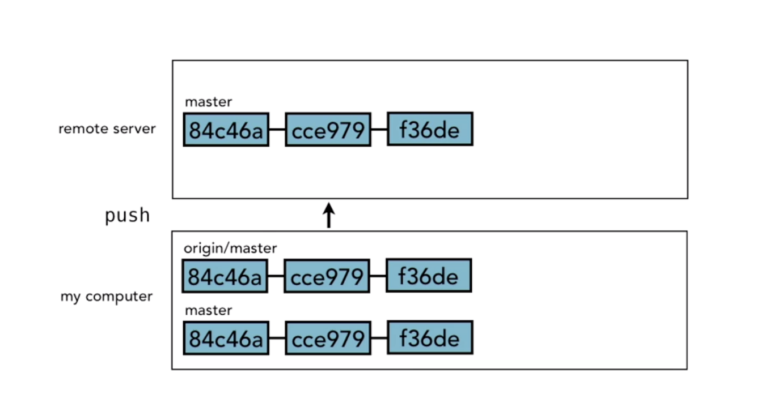
Remotes

Slide 40
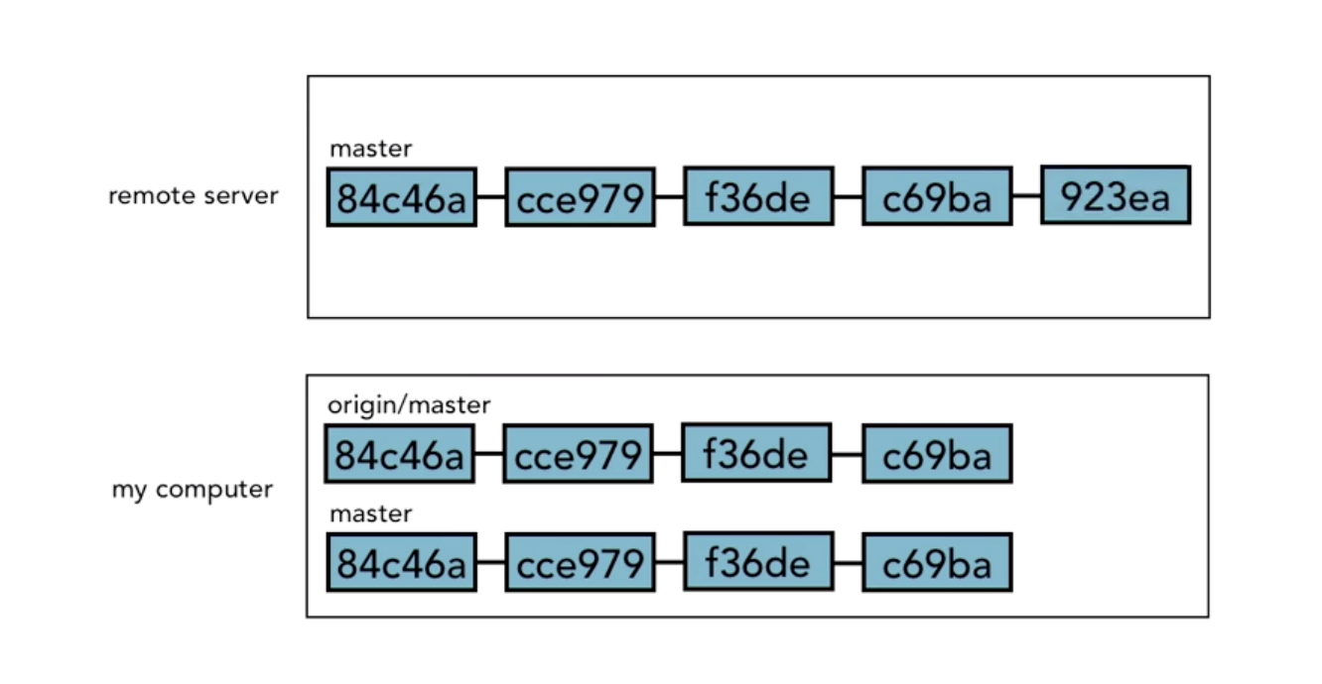
Remotes

Slide 41
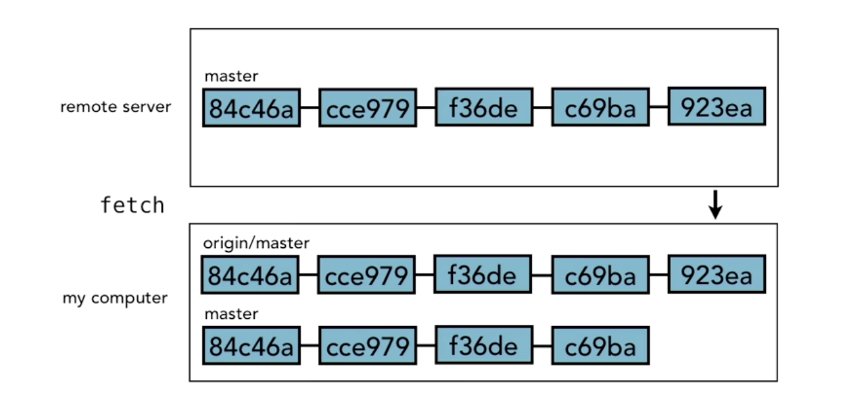
Remotes

Slide 42
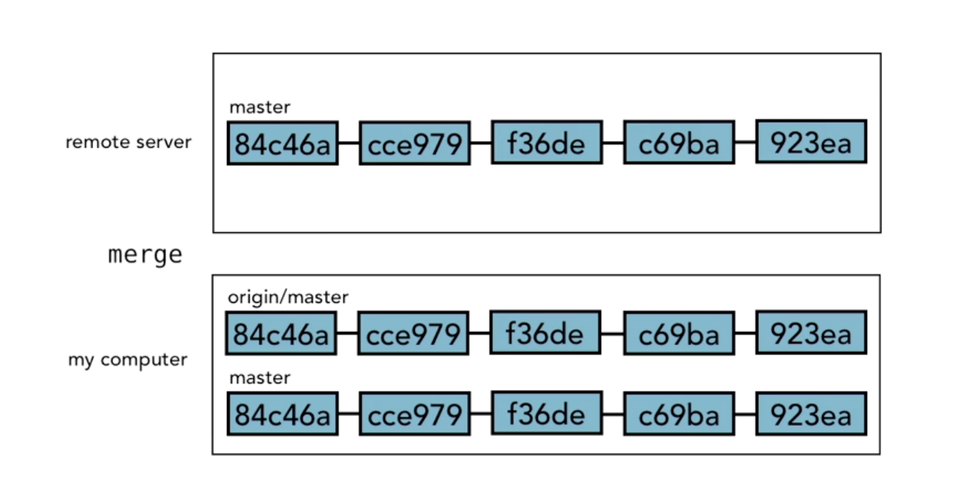
Remotes

Slide 43
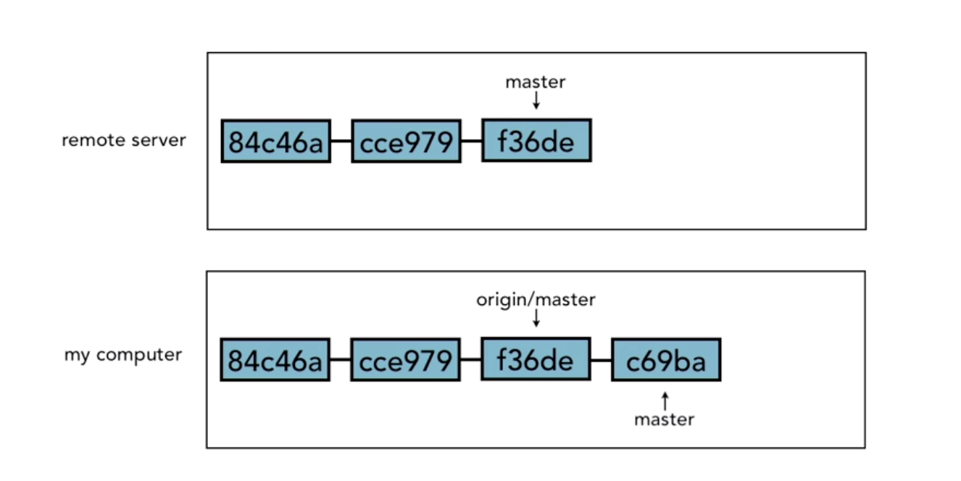
Remotes
If we make the change

Slide 44
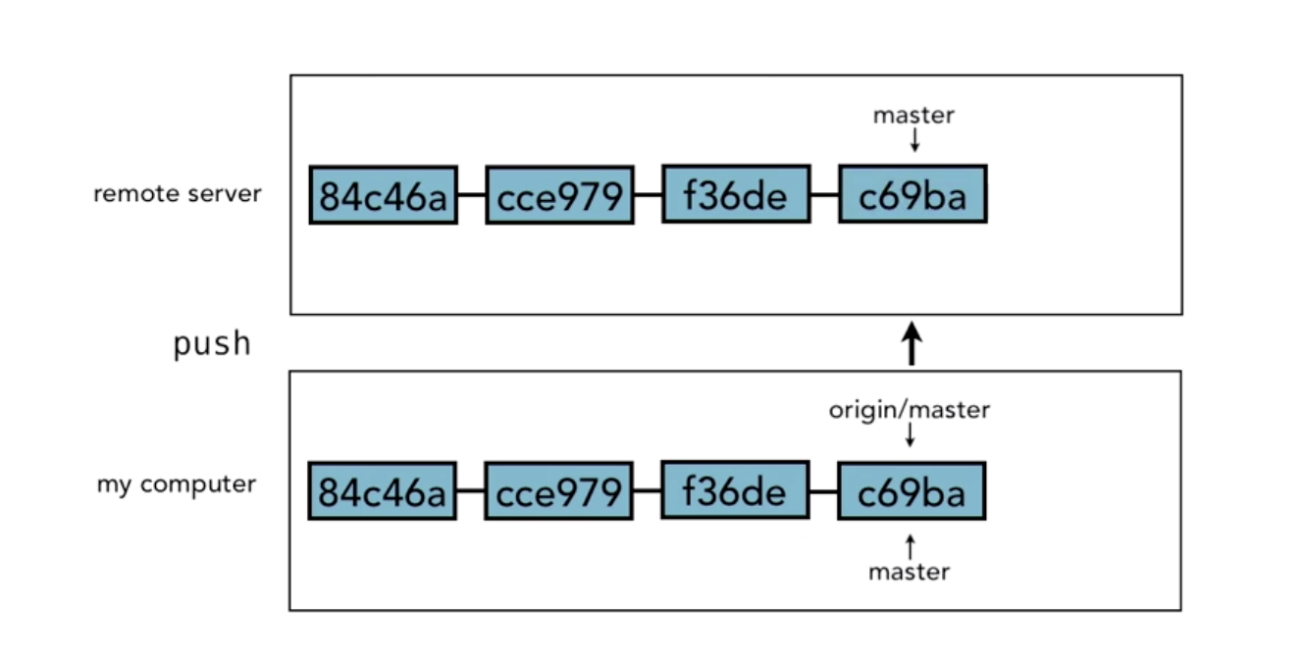
Remotes
Push it

Slide 45
Remotes
Adding remote
git remote add <remote_name> <url>
View
git remote -v
Remove
git remote rm​ <remote_name>

Slide 46
Remotes
Pushing the change
git push -u <remote_name> <branch_name>
Show brach
git branch (local)
git branch -r (remote)
git branch -a (both)

Slide 47
Remotes
Clone remote
git clone <url>
Fetching
Fetch before you work
Fetch before you push
Fetch often

Slide 48
Remotes
Merging
git merge <target_branch>

Slide 49
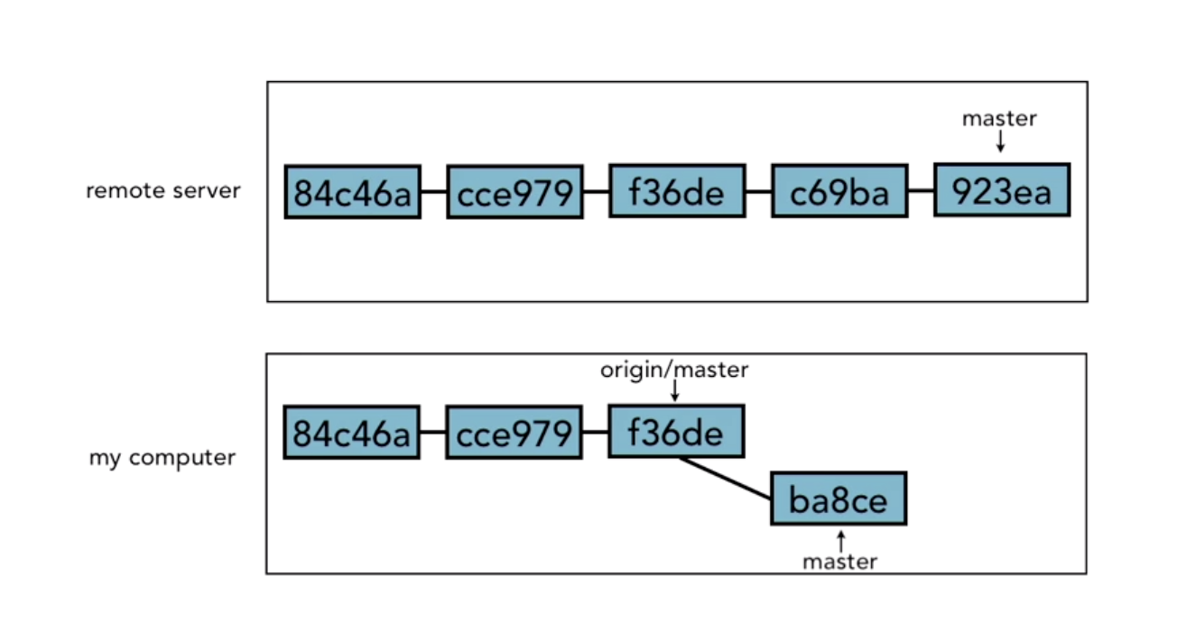
Remotes
Push to updated branch

Slide 50
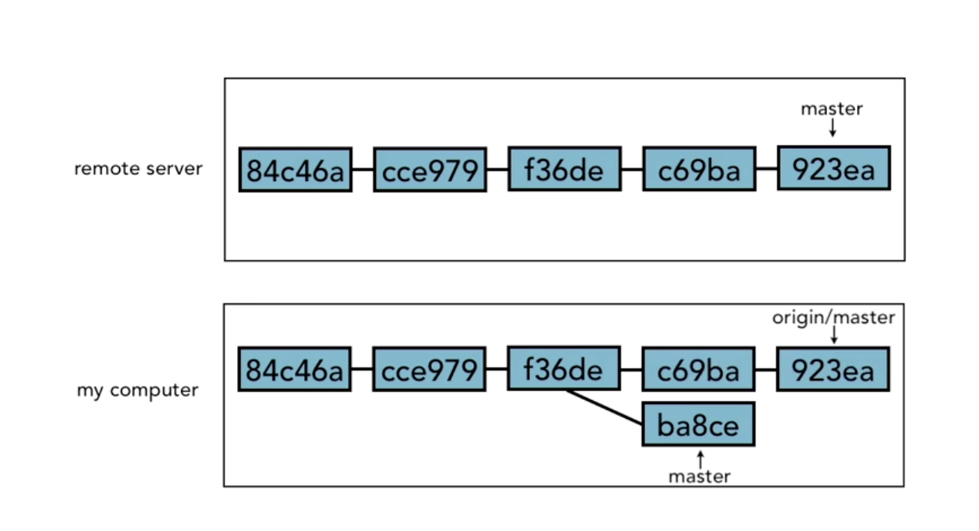
Remotes
Update

Slide 51
Remotes
Delete branch
git branch -d <branch_name>

Slide 52
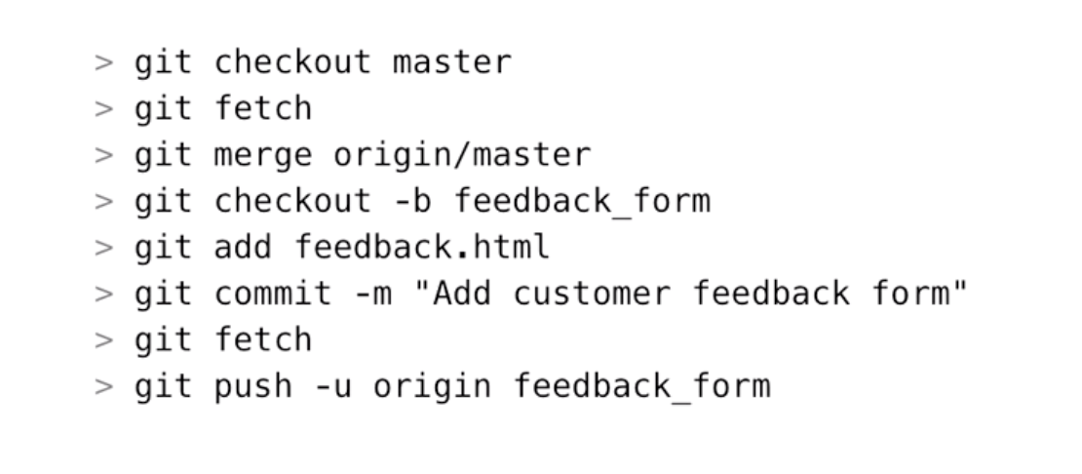
Remotes
Workflow

Slide 53
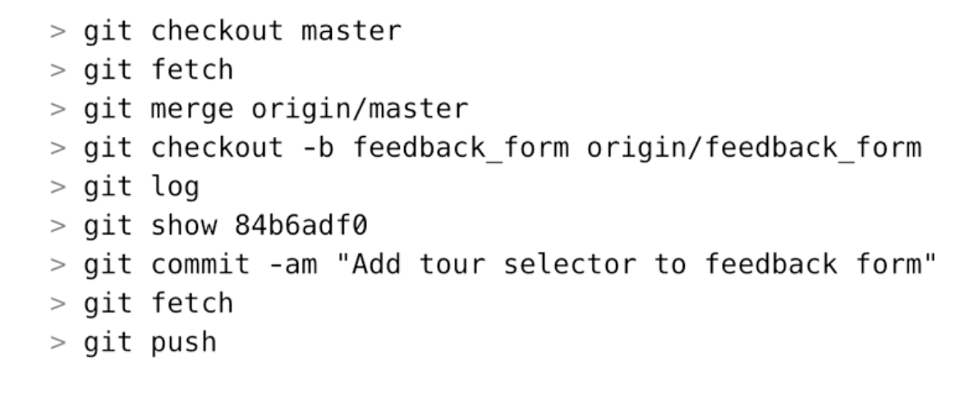
Remotes
Someone do something

Slide 54
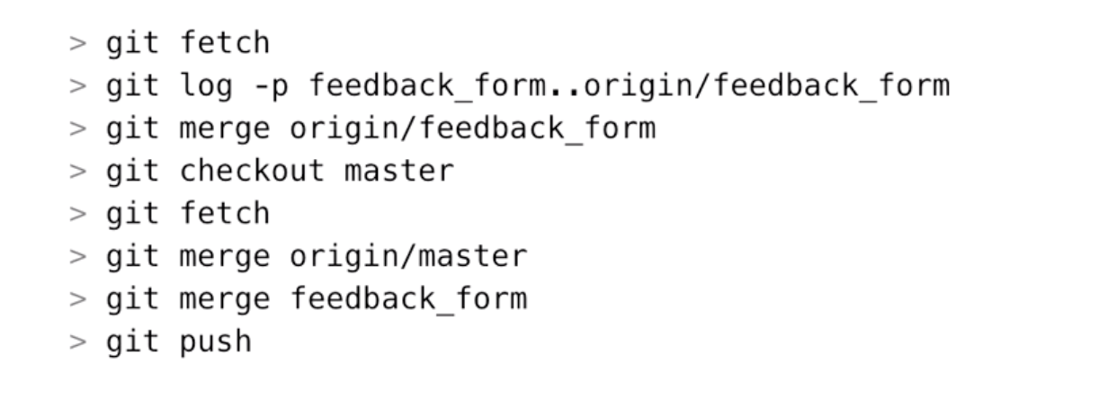
Remotes
Workflow

Slide 55
Tools and next steps

Slide 56
Tools and next steps
Set up alias
git config --global alias.st “status”
git config --global alias.co “checkout”

Slide 57
SSH
Generate ssh
ssh-keygen
Copy .pub and paste into git setting

Slide 58
ttps://medium.com/altotech/how-to-use-git-and-github-pea-hive-68b7af3e513b

